Slide 1

Notes:
s

Slide 2
PRESENTATION ADVANCE PYHTHON INDUSTIAL TRANNING BY DEEPIKA NEGI (01826418118) B.Voc(SD) SEM-4th

Slide 3
Introduction To Python
Python is a interpreted, interactive and object-oriented language. Python is designed to be highly readable. It uses English keywords frequently where as other languages use punctuation, and it has fewer syntactical constructions than other languages.
Python is a MUST for students and working professionals to become a great Software Engineer specially when they are working in Web Development Domain. I will list down some of the key advantages of learning Python:
Python is Interpreted − Python is processed at runtime by the interpreter. We do not need to compile your program before executing it.
Python is Interactive − You can actually sit at a Python prompt and interact with the interpreter directly to write your programs.
Python is Object-Oriented − Python supports Object-Oriented style or technique of programming that encapsulates code within objects.
Python is a Beginner's Language − Python is a great language for the beginner-level programmers and supports the development of a wide range of applications from simple text processing to WWW browsers to games.
•

Slide 4
MY MINI PROJECT ON ATM Simulator (ADVANCE PYTHON)

Slide 5
ABOUT MY PROJECT
ATM Simulator project is written in Python. The project file contains a python script (atm.py). This is a simple console based system which is very easy to use. Talking about the system, it contains various functions which include Account Statement, Withdrawing, Depositing amount and changing the pin. Here, at first the user has to enter an existing username, when the username matches the system proceed toward the next procedure i.e asking pin number. When a user passes all these sign-in procedures, he/she can use all those features. It is too easy to use, he/she can check their respective account statements.

Slide 6
While depositing or withdrawing amount, he/she just has to enter the amount then the system calculates the total remaining balance of the respective account and displays to the user. And the user can view all these transactions from the account statement. In this ATM Simulator, the user can also change the pin number. For this, the user has to enter the New pin code and then confirm it in order to change the pin code. This simple console based ATM simulator provides the simple account balance management of a respective account. It contains all the essential features. There is no database connection or neither any external text or other files used in this mini project to save user’s data. Everything is set inside the source code whether its pin code or the amount.

Slide 7
Features:
Sign In
Account Statement
Withdraw amount
Lodge amount
Change Pin
s

Slide 8
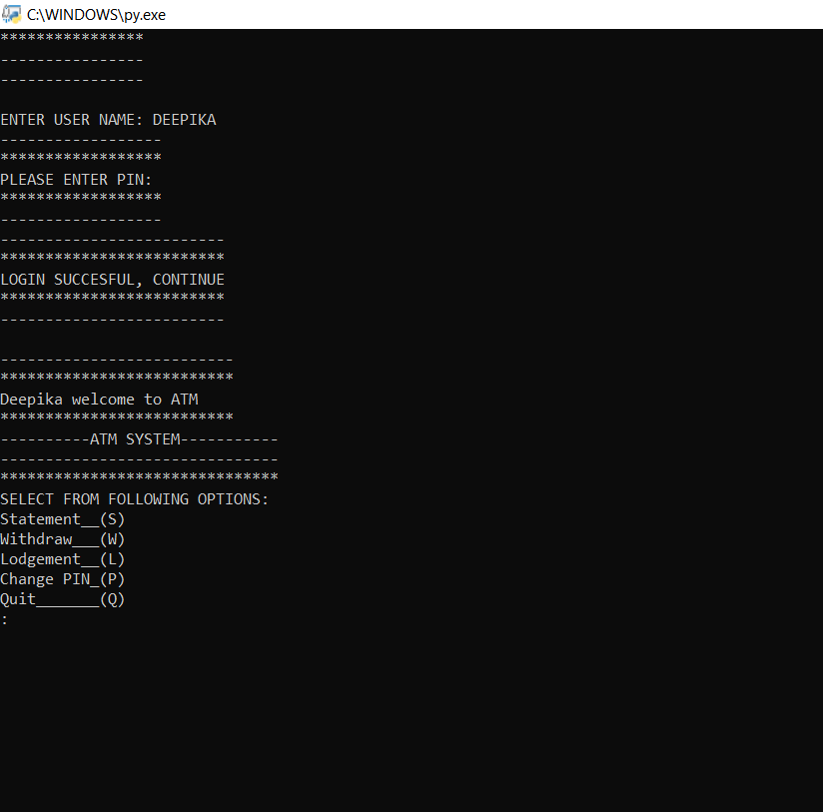
SIGN IN

Slide 9
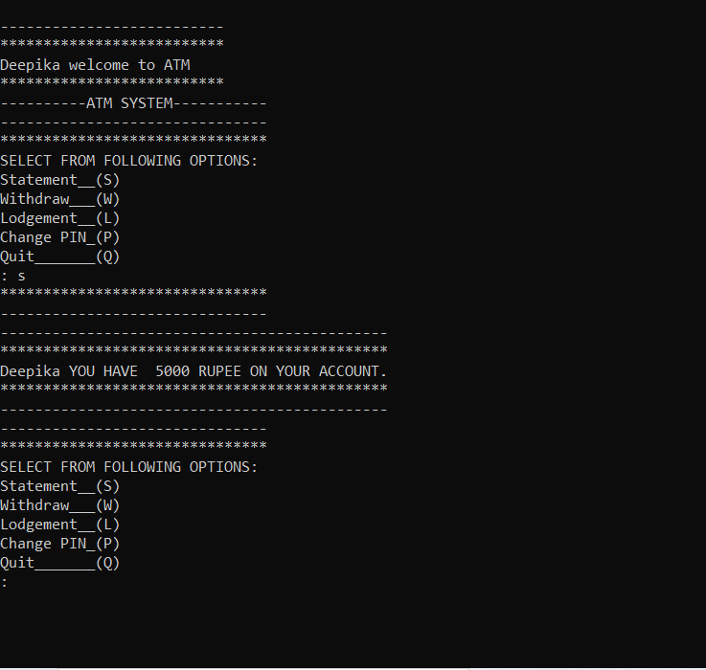
ACCOUNT STATEMENT

Slide 10
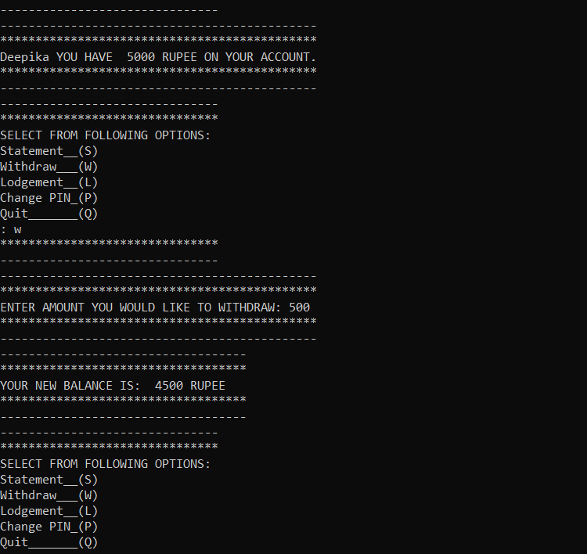
WITHDRAW AMOUNT

Slide 11
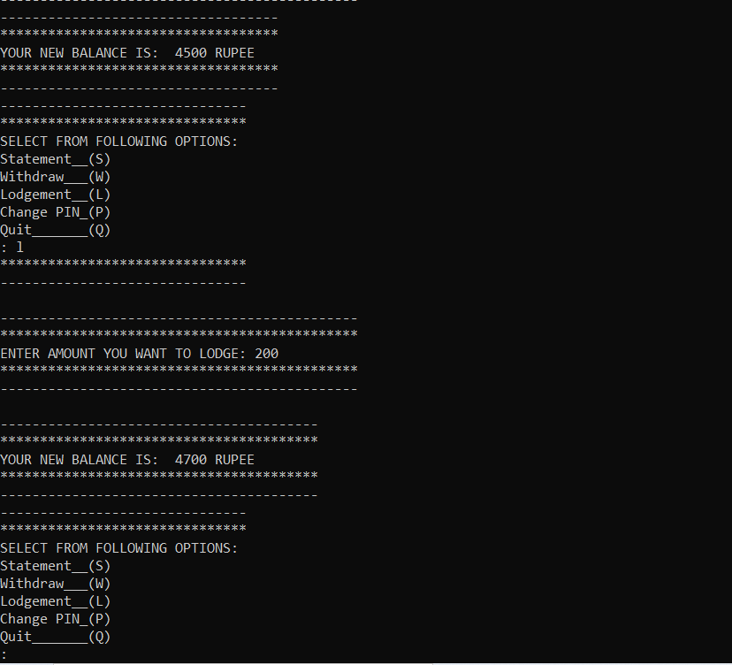
LODGE AMOUNT

Slide 12
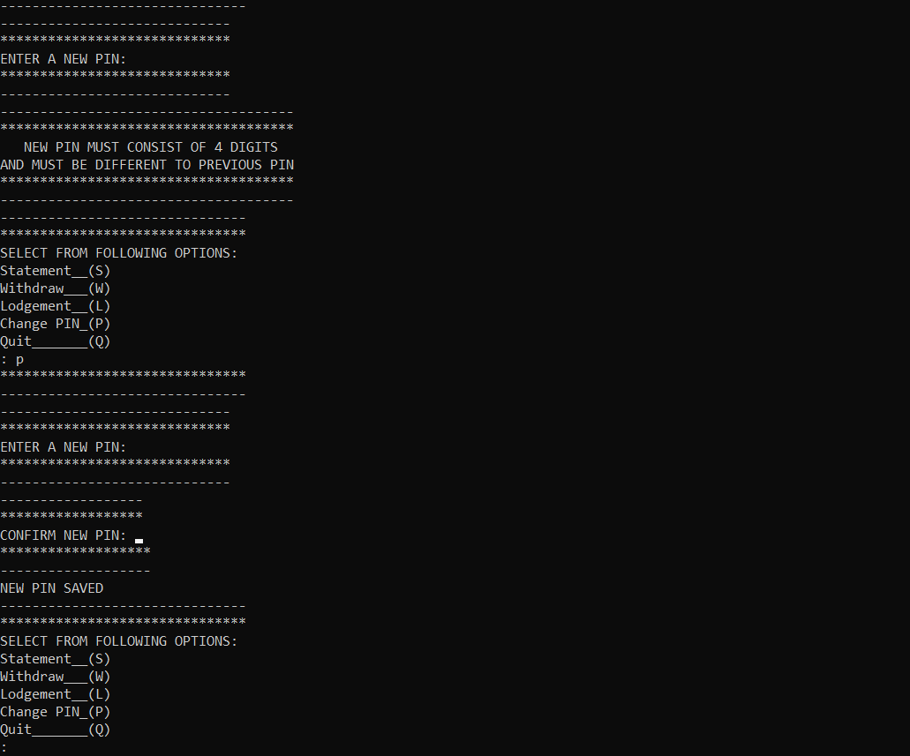
CHANGE PIN

Slide 13
THRORETICAL STUDY OF PYHTHON

Slide 14
Features
As mentioned before, Python is one of the most widely used language over the web.
Easy-to-learn − Python has few keywords, simple structure, and a clearly defined syntax. This allows the student to pick up the language quickly.
Easy-to-read − Python code is more clearly defined and visible to the eyes.
Easy-to-maintain − Python's source code is fairly easy-to-maintain.  A broad standard library − Python's bulk of the library is very portable and cross-platform compatible on UNIX, Windows, and Macintosh.
Interactive Mode − Python has support for an interactive mode which allows

Slide 15
First Program of Python
//Program to print hello world!
>>>print(“Hello World!”)
Output
Hello World!
Python Identifiers
A Python identifier is a name used to identify a variable, function, class, module or other object. An identifier starts with a letter A to Z or a to z or an underscore (_) followed by zero or more letters, underscores and digits (0 to 9).
Python does not allow punctuation characters such as @, $, and % within identifiers. Python is a case sensitive programming language.
For Example-
Manpower and manpower are two different identifiers in Python.

Slide 16
Reserved Word
These are reserved words and you cannot use them as constant or variable or any other identifier names. All the Python keywords contain lowercase letters only.
The following list shows the Python keywords.
And | Exec | Not
Assert | Finally | Or
Break | For | Pass
Class | From | Print
Continue | Global | Raise
Def | If | return
Del | Import | try

Slide 17
Elif | In | while
Else | Is | with
Except | Lambda | yield
Lines and Indentation
Python provides no braces to indicate blocks of code for class and function definitions or flow control. Blocks of code are denoted by line indentation, which is rigidly enforced.
The number of spaces in the indentation is variable, but all statements within the block must be indented the same amount.
For example − if True:
print “True”
else:
print “False”
However, the following block generates an error−

Slide 18
If True:
print ”Answer” print “True” else:
print ”Answer” print “False”
Thus, in Python all the continuous lines indented with same number of spaces would form a block.
Quotation in Python
Python accepts single ('), double (") and triple (''' or """) quotes to denote string literals, as long as the same type of quote starts and ends the string.
The triple quotes are used to span the string across multiple lines. For example, all the following are legal − word=‘word’
sentence=“This is a sentence.”
paragraph=“””This is a paragraph. It is made up of multiple lines and sentences.”””
Comments in Python
A hash sign (#) that is not inside a string literal begins a comment. All characters after the # and up to the end of the physical line are part of the comment and the Python interpreter ignores them.
Code-
#First comment

Slide 19
Print “Hello, Python!”
#Second comment
This produce the following result
Hello, Python!
Variable
Variables are nothing but reserved memory locations to store values. This means that when you create a variable you reserve some space in memory.
Based on the data type of a variable, the interpreter allocates memory and decides what can be stored in the reserved memory. Therefore, by assigning different data types to variables, you can store integers, decimals or characters in these variables.
Assigning Values to Variables-
Python variables do not need explicit declaration to reserve memory space. The declaration happens automatically when you assign a value to a variable. The equal sign (=) is used to assign values to variables.
The operand to the left of the = operator is the name of the variable and the operand to the right of the = operator is the value stored in the variable.

Slide 20
For example −
Counter=100 #An integer assignment
Miles=1000.0
Name=‘John’
Print counter
Print miles
Print name
#A Floating point
#A string
Here, 100, 1000.0 and "John" are the values assigned to counter, miles, and name variables, respectively. This produces the following result −
100
John

Slide 21
Python Numbers
Number data types store numeric values. Number objects are created when you assign a value to them. For example −
Var1=1
Var2=10
Python supports four different numerical types –
int (signed integers)
long (long integers, they can also be represented in octal and hexadecimal)
float (floating point real values)
complex (complex numbers)

Slide 22
The plus (+) sign is the string concatenation operator and the asterisk (*) is the repetition operator. For example −
str=‘Hello World!’
print str #prints complete string
print str[0] #Print first character of the string
print str[2:5] #Print character starting from3rd to 5th
print str[2:] #Print string starting from 3rd
print str*2 #Print string two times  print str+ “’TEST”
This will produce the following result-
hello World!
H
llo
llo World!
Hello World! Hello World!
Hello World! TEST
#Print concatenated string

Slide 23
Operators
Operators are the constructs which can manipulate the value of operands.
Consider the expression 4 + 5 = 9. Here, 4 and 5 are called operands and + is called operator.
Types of Operator
Python language supports the following types of operators.
Arithmetic Operators
Comparison (Relational) Operators
Assignment Operators
Logical Operators
Bitwise Operators

Slide 24
Operator | Description | Example
+ Addition | Adds values on either side of the operator. | a + b = 30
- Subtraction | Subtracts right hand operand from left hand operand. | a – b = -10
* Multiplication | Multiplies values on either side of the operator | a * b = 200
/ Division | Divides left hand operand by right hand operand | b / a = 2
% Modulus | Divides left hand operand by right hand operand and returns remainder | b % a = 0
** Exponent | Performs exponential (power) calculation on operators | a**b =10 to the power 20

Slide 25
//
Floor Division - The division of operands where the result is the quotient in which the digits after the decimal point are removed. But if one of the operands is negative, the result is floored, i.e., rounded away from zero (towards negative infinity)
−
9//2 = 4 and 9.0//2.0 = 4.0, -11//3 = -4, -11.0//3 = -
4.0
Python Comparison Operators
These operators compare the values on either sides of them and decide the relation among them. They are also called Relational operators.
Assume variable a holds 10 and variable b holds 20, then −

Slide 26
Operator | Description | Example
== | If the values of two operands are equal, then the condition becomes true. | (a == b) is not true.
!= | If values of two operands are not equal, then condition becomes true. | (a != b) is true.
<> | If values of two operands are not equal, then condition becomes true. | (a <> b) is true. This is similar to != operator.
> | If the value of left operand is greater than the value of right operand, then condition becomes true. | (a > b) is not true.
< | If the value of left operand is less than the value of right operand, then condition becomes true. | (a < b) is true.

Slide 27
>= | If the value of left operand is greater than or equal to the value of right operand, then condition becomes true. | (a >= b) is not true.
<= | If the value of left operand is less than or equal to the value of right operand, then condition becomes true. | (a <= b) is true.
Python Assignment Operators
Assume variable a holds 10 and variable b holds 20, then −

Slide 28
Operator | Description | Example
= | Assigns values from right side operands to left side operand | c = a + b assigns value of a + b into c
+= Add AND | It adds right operand to the left operand and assign the result to left operand | c += a is equivalent to c = c + a
-= Subtract AND | It subtracts right operand from the left operand and assign the result to left operand | c -= a is equivalent to c = c - a
*= Multiply AND | It multiplies right operand with the left operand and assign the result to left operand | c *= a is equivalent to c = c * a
/= Divide AND | It divides left operand with the right operand and assign the result to left operand | c /= a is equivalent to c = c / ac /= a is equivalent to c = c / a
%= Modulus AND | It takes modulus using two operands and assign the result to left operand | c %= a is equivalent to c = c % a
**= Exponent AND | Performs exponential (power) calculation on operators and assign value to the left operand | c **= a is equivalent to c = c ** a

Slide 29
//= Floor Division | It performs floor division on operators and assign value to the left operand | c //= a is equivalent to c = c // a
Python Bitwise Operators
Bitwise operator works on bits and performs bit by bit operation. Assume if a = 60; and b = 13; Now in binary format they will be as follows −
a = 0011 1100
b = 0000 1101
a&b = 0000 1100
a|b = 0011 1101
a^b = 0011 0001
~a = 1100 0011
There are following Bitwise operators supported by Python language

Slide 30
Operator | Description | Example
& Binary AND | Operator copies a bit to the result if it exists in both operands | (a & b) (means 0000 1100)
| Binary OR | It copies a bit if it exists in either operand. | (a | b) = 61 (means 0011 1101)
^ Binary XOR | It copies the bit if it is set in one operand but not both. | (a ^ b) = 49 (means 0011 0001)
~ Binary Ones Complement | It is unary and has the effect of 'flipping' bits. | (~a ) = -61 (means 1100 0011 in 2's complement form due to a signed binary number.
<< Binary Left Shift | The left operands value is moved left by the number of bits specified by the right operand. | a << 2 = 240 (means 1111 0000)
>> Binary Right Shift | The left operands value is moved right by the number of bits specified by the right operand. | a >> 2 = 15 (means 0000 1111)

Slide 31
Python Logical Operators
There are following logical operators supported by Python language. Assume variable a holds 10 and variable b holds 20 then
Operator | Description | Example
and Logical AND | If both the operands are true then condition becomes true. | (a and b) is true.
or Logical OR | If any of the two operands are nonzero then condition becomes true. | (a or b) is true.
not Logical NOT | Used to reverse the logical state of its operand. | Not(a and b) is false.

Slide 32
Decision Making
Decision making is anticipation of condition occurring while execution of the program and specifying actions taken according to the conditions.
Decision structures evaluate multiple expressions which produce TRUE or FALSE as outcome. You need to determine which action to take and which statements to execute if outcome is TRUE or FALSE otherwise.
Following is the general form of a typical decision making structure found in most of the programming languages −

Slide 33
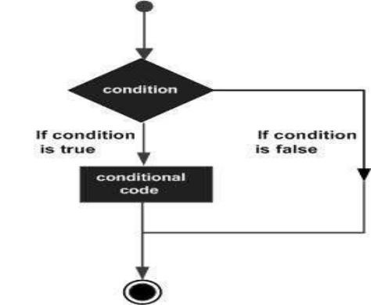

Slide 34
Python If ... Else
Python programming language assumes any non-zero and nonnull values as TRUE, and if it is either zero or null, then it is assumed as FALSE value.
Python Conditions and If statements
Python supports the usual logical conditions from mathematics:
Equals: a == b
Not Equals:
a != b
Less than:
a < b
Less than or equal to:
a <= b
Greater than:
a > b
Greater than or equal to:
a >= b

Slide 35
These conditions can be used in several ways, most commonly in "if statements" and loops.
An "if statement" is written by using the if keyword.
Example
If statement:
a = 33
b = 200
if b > a:
print("b is greater than a")
In this example we use two variables, a and b, which are used as part of the if statement to test whether b is greater than a. As a is 33, and b is 200, we know that 200 is greater than 33, and so we print to screen that "b is greater than a".
Indentation
Python relies on indentation (whitespace at the beginning of a line) to define scope in the code. Other programming languages often use curly-brackets for this purpose.
Example
If statement, without indentation (will raise an error):

Slide 36
a = 33
b = 200
if b > a:
print("b is greater than a") # you will get an error
Elif
The elif keyword is pythons way of saying "if the previous conditions were not true, then try this condition".
Example
a = 33
b = 33
if b > a:
print("b is greater than a") elif a == b:
print("a and b are equal")

Slide 37
In this example | a is equal to b | , so the first condition is not true, but the | elif | condition is true, so we print to
screen that "a and b are equal".
Else
The else keyword catches anything which isn't caught by the preceding conditions.
Example
a = 200
b = 33
if b > a:
print("b is greater than a") elif a == b:
print("a and b are equal") else:
print("a is greater than b")
In this example a is greater than b, so the first condition is not true, also the
elif
condition is not true, so we go
to the else condition and print to screen that "a is greater than b".
You can also have an
else
without the
elif
:

Slide 38
Example
a = 200
b = 33
if b > a:
print("b is greater than a") else:
print("b is not greater than a")
Short Hand If
If you have only one statement to execute, you can put it on the same line as the if statement.
Example
One line if statement:
a = 200
b = 33
if a > b: print("a is greater than b")

Slide 39
Short Hand If ... Else
If you have only one statement to execute, one for if, and one for else, you can put it all on the same line:
Example
One line if else statement:
a = 2
b = 330
print("A") if a > b else print("B")
This technique is known as Ternary Operators, or Conditional Expressions.
You can also have multiple else statements on the same line:
Example
One line if else statement, with 3 conditions:

Slide 40
a = 330
b = 330
print("A") if a > b else print("=") if a == b else print("B")
And
The and keyword is a logical operator, and is used to combine conditional statements:
Example
Test if a is greater than b, AND if c is greater than a:
a = 200
b = 33
c = 500
if a > b and c > a:
print("Both conditions are True")

Slide 41
Or
The or keyword is a logical operator, and is used to combine conditional statements:
Example
Test if a is greater than b, OR if a is greater than c:
a = 200
b = 33
c = 500
if a > b or a > c:
print("At least one of the conditions is True")
Nested If
You can have if statements inside if statements, this is called nested if statements.
Example
x = 41
if x > 10:

Slide 42
print("Above ten,")
if x > 20:
print("and also above 20!") else:
print("but not above 20.")
The pass Statement
if
statements cannot be empty, but if you for some reason have an
if
statement with no content, put in
the
pass
statement to avoid getting an error.
Example
a = 33
b = 200
if b > a: pass

Slide 43
Python Loops
In general, statements are executed sequentially: The first statement in a function is executed first, followed by the second, and so on. There may be a situation when you need to execute a block of code several number of times.
Programming languages provide various control structures that allow for more complicated execution paths.
A loop statement allows us to execute a statement or group of statements multiple times. The following diagram illustrates a loop statement-

Slide 44
Python Loops
Python programming language provides following types of loops to handle looping requirements.
Python has two primitive loop commands:
•
•
whi
le loops
for
loops
The while Loop
With the while loop we can execute a set of statements as long as a condition is true.
Example
Print i as long as i is less than 6:
i = 1
while i < 6: print(i)
i += 1

Slide 45
Note: remember to increment i, or else the loop will continue forever.
The | while | loop requires relevant variables to be ready, in this example we need to define an indexing variable, i | , which we
set to 1.
The break Statement
With the break statement we can stop the loop even if the while condition is true:
Example
Exit the loop when i is 3:
i = 1
while i < 6: print(i) if i == 3:
break i += 1

Slide 46
The continue Statement
With the continue statement we can stop the current iteration, and continue with the next:
Example
Continue to the next iteration if i is 3:
i = 0
while i < 6: i += 1
if i == 3: continue
print(i)
The else Statement
With the else statement we can run a block of code once when the condition no longer is true:
Example
Print a message once the condition is false:

Slide 47
i = 1
while i < 6: print(i) i += 1
else:
print("i is no longer less than 6")
Python For Loops
A for loop is used for iterating over a sequence (that is either a list, a tuple, a dictionary, a set, or a string).
This is less like the for keyword in other programming languages, and works more like an iterator method as found in other object-orientated programming languages.
With the for loop we can execute a set of statements, once for each item in a list, tuple, set etc.
Example
Print each fruit in a fruit list:
fruits = ["apple", "banana", "cherry"] for x in fruits:
print(x)
The
for
loop does not require an indexing variable to set beforehand.

Slide 48
Looping Through a String Even strings are iterable objects, they contain a sequence of characters:
Example Loop through the letters in the word "banana":
for x in "banana": print(x)
The break Statement
With the break statement we can stop the loop before it has looped through all the items:
Example
Exit the loop when x is "banana":
fruits = ["apple", "banana", "cherry"]
for x in fruits: print(x)
if x == "banana":

Slide 49
break
Example Exit the loop when x is "banana", but this time the break comes before the print:
fruits = ["apple", "banana", "cherry"] for x in fruits: if x == "banana": break print(x)
The continue Statement
With the continue statement we can stop the current iteration of the loop, and continue with the next:
Example
Do not print banana:

Slide 50
fruits = ["apple", "banana", "cherry"]
for x in fruits: if x == "banana":
continue
print(x)
The range() Function
To loop through a set of code a specified number of times, we can use the range() function,
The range() function returns a sequence of numbers, starting from 0 by default, and increments by 1 (by default), and ends at a specified number.
Example
Using the range() function:
for x in range(6):
print(x)
Note that
range(6)
is not the values of 0 to 6, but the values 0 to 5.
The
range()
function defaults to 0 as a starting value, however it is possible to specify the starting value by adding a
parameter:
range(2, 6)
, which means values from 2 to 6 (but not including 6):

Slide 51
Example
Using the start parameter:
for x in range(2, 6):
print(x)
The range() function defaults to increment the sequence by 1, however it is possible to specify the increment value by adding a third parameter: range(2, 30, 3):
Example
Increment the sequence with 3 (default is 1):
for x in range(2, 30, 3):
print(x)
Else in For Loop
The
else
keyword in a
for
loop specifies a block of code to be executed when the loop is finished:

Slide 52
Example
Print all numbers from 0 to 5, and print a message when the loop has ended:
for x in range(6):
print(x) else:
print("Finally finished!")
Nested Loops
A nested loop is a loop inside a loop.
The "inner loop" will be executed one time for each iteration of the "outer loop":
Example
Print each adjective for every fruit:
adj = ["red", "big", "tasty"]
fruits = ["apple", "banana", "cherry"]
for x in adj:
for y in fruits: print(x, y)

Slide 53
The Pass Statement
for
loops cannot be empty, but if you for some reason have a
for
loop with no content, put in the
pass
statement to avoid
getting an error.
Example
for x in [0, 1, 2]:
pass

Slide 54
Python Sequence
A sequence is a succession of values bound together by a container that reflects their type.
Almost every stream that you put in Python is a sequence.
Types of Sequences
Lists
Tuples
Xrange
String
List
A list is a sort of container that holds a number of other objects, in a given
order.
The list type implements the sequence protocol, and it also allows you to add
and remove objects from the sequence.
It is an ordered set of elements enclosed in square brackets.
Simple definition of list – li = []
li = list() # empty list li = list(sequence)
li = list(expression for variable in sequence)

Slide 55
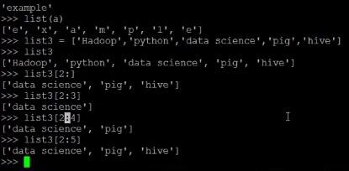
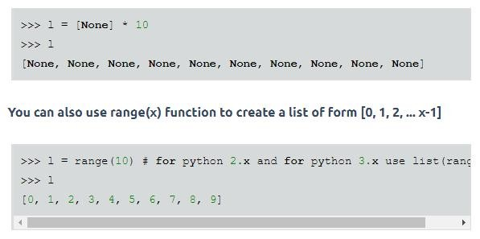
Iterating through elements in a List

Slide 56
To iterate through a list we can use for loop as follows:
1 >>>
2 >>> marks = [122, 45, 23, 78, 65, 12]
>>> for m in marks:
... print(m) 5 ...
6 122
7 45
8 23
9 78
10 65
11 12
12 >>>

Slide 57
2 >>> marks = [122, 45, 23, 78, 65, 12]
3 >>>
4 >>> import random 5 >>>
>>> for i in range(len(marks)):
... marks[i] = random.randint(1, 100) # assign some random value between 1 to 100 to all elements 8 ...
9 >>>
10 >>> marks
11 [59, 9, 59, 21, 75, 61]
12 >>>
13 >>>
1 >>>
2 >>> i = 0

Slide 58
3 >>>
>>> while i < len(marks):
... print(marks[i]) 6 ... i += 1
7 ...
8 59
9 9
10 59
11 21
12 75
13 61
14 >>>
15 >>>

Slide 59
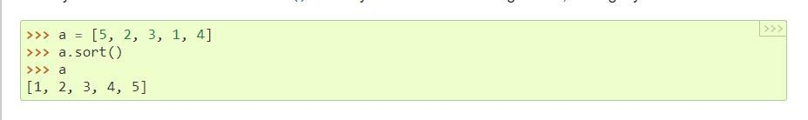
Sorted list
Python lists have a built-in list.sort() method that modifies the list in-place. There is also a sorted() built-in
function that builds a new sorted list from an iterable.
A simple ascending sort is very easy: just call the sorted() function. It returns a new sorted list:
you can also use the list.sort() method. It modifies the list in-place (and returns than sorted() - but if you don’t need the original list, it’s slightly more efficient.
None
to avoid confusion). Usually it’s less convenient
Python Tuple
The Python Tuple is almost similar to a List except that the Tuples are immutable, and Lists are mutable. It means Once we declare the Python Tuple, we cannot change the values or items inside the Tuple, something like Constant keyword in other programming languages.

Slide 60
A Python Tuple is a sequence of multiple values in an ordered sequence. Tuples are declared using Open and Closed Parenthesis ( ). Unlike Python Strings, Tuple allows us to store different types of data such as integer, float, string, etc.
How to Declare Python Tuple?
The following are the list of possible ways to declare a Tuple in Python.
Tuple_Name = () is an empty Tuple that contains no values.
String_Tuple = (‘apple’, ‘Orange’, ‘Grape’, ‘Mango’) is a string tuple that contains four string values.
Mixed_Tuple = (‘apple’, 2, 3.50, ‘Mango’) is a mixed tuple that contains one integer, one float, and two integer values. Nested_Tuple = (‘Python’, ‘Tutorial’, (1, 2, 3) ) is an example of tuple inside another tuple (Nested Tuple)
List_Tuple = (‘Python’, ‘Tutorial’, [1, 2, 3] ) is an example of List inside a tuple

Slide 61
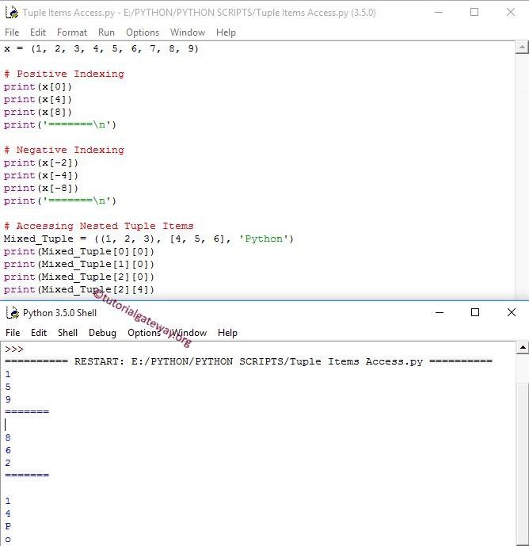

Slide 62
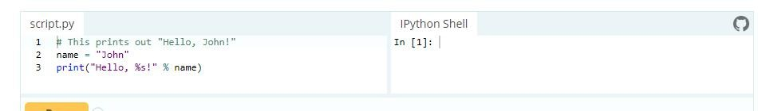
String Formatting
Python uses C-style string formatting to create new, formatted strings. The "%" operator is used to format a set of variables enclosed in a "tuple" (a fixed size list), together with a format string, which contains normal text together with "argument specifiers", special symbols
like "%s" and "%d".

Slide 63
sets — Unordered collections of unique elements
The sets module provides classes for constructing and manipulating unordered collections of unique elements. Common uses include membership testing, removing duplicates from a sequence, and computing standard math operations on sets such as intersection, union, difference, and symmetric difference.
Like other collections, sets support x in set, len(set), and for x in set. Being an unordered collection, sets do not record element position or order of insertion. Accordingly, sets do not support indexing, slicing, or other sequence-like behavior.
Most set applications use the Set class which provides every set method except for hash (). For advanced applications requiring a hash method, the ImmutableSet class adds a hash () method but omits methods which alter the contents of the set. Both Set and ImmutableSet derive from BaseSet, an abstract class useful for determining whether something is a set: isinstance(obj, BaseSet).
The set classes are implemented using dictionaries. Accordingly, the requirements for set elements are the same as those for dictionary keys; namely, that the element defines both eq () and hash (). As a result, sets cannot contain mutable elements such as lists or dictionaries. However, they can contain immutable collections such as tuples or instances of ImmutableSet. For convenience in implementing sets of sets, inner sets are automatically converted to immutable form, for example, Set([Set(['dog'])]) is transformed to Set([ImmutableSet(['dog'])]).
Constructs a new empty Set object. If the optional iterable parameter is supplied, updates the set with elements obtained from iteration. All of the elements in iterable should be immutable or be transformable to an immutable using the protocol described in section Protocol for automatic conversion to immutable.

Slide 64
File Handling
The key function for working with files in Python is the open() function. The open() function takes two parameters; filename, and mode.
There are four different methods (modes) for opening a file:
"r" - Read - Default value. Opens a file for reading, error if the file does not exist
"a" - Append - Opens a file for appending, creates the file if it does not exist
"w" - Write - Opens a file for writing, creates the file if it does not exist
"x" - Create - Creates the specified file, returns an error if the file exists
In addition you can specify if the file should be handled as binary or text mode
"t" - Text - Default value. Text mode
"b" - Binary - Binary mode (e.g. images)

Slide 65
What are exceptions in Python?
Python has many built-in exceptions which forces your program to output an error when something in it goes wrong.
When these exceptions occur, it causes the current process to stop and passes it to the calling process until it is handled. If not handled, our program will crash.
For example, if function calls function which in turn calls function
and an exception occurs in
A
B
C
function C. If it is not handled in C, the exception passes to and then to A.
B
If never handled, an error message is spit out and our program come to a sudden, unexpected halt.
Catching Exceptions in Python
In Python, exceptions can be handled using a try statement.
A critical operation which can raise exception is placed inside the try clause and the code that handles exception is written in except clause.
It is up to us, what operations we perform once we have caught the exception. tfere is a simple example.

Slide 66
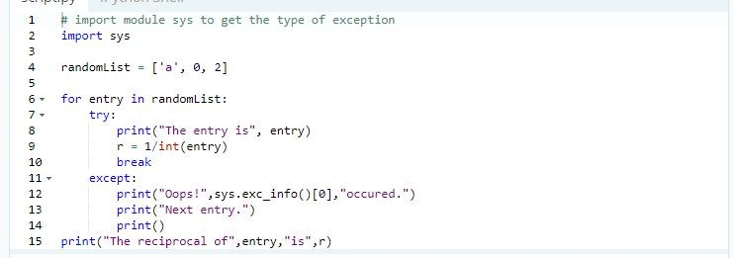
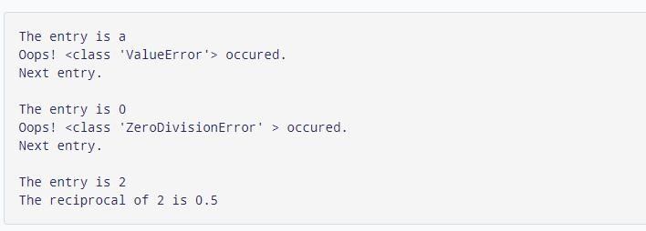

Slide 67
Catching Specific Exceptions in Python
This is not a good programming practice as it will catch all exceptions and handle every case in the same way. We can specify which exceptions an except clause will catch.
A try clause can have any number of except clause to handle them differently but only one will be executed in case an exception occurs.
We can use a tuple of values to specify multiple exceptions in an except clause. tfere is an example pseudo code.

Slide 68
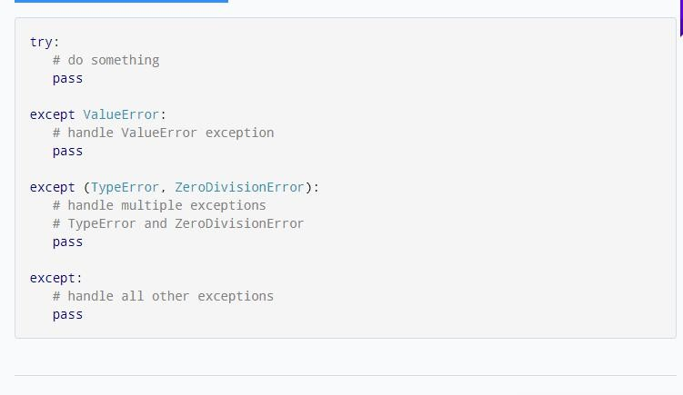
try...finally
The try statement in Python can have an optional and is generally used to release external resources.
clause. This clause is executed no matter what,
finally
For example, we may be connected to a remote data center through the network or working with a file or working with a Graphical User Interface (GUI).
In all these circumstances, we must clean up the resource once used, whether it was successful or not. These actions (closing a file, GUI or disconnecting from network) are performed in the finally clause to guarantee execution.

Slide 69
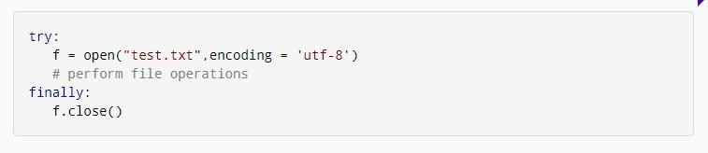
tfere is an example of file operations to illustrate this.
Python Dictionary
Dictionary in Python is an unordered collection of data values, used to store data values like a map, which unlike other Data Types that hold only single value as an element, Dictionary holds key:value pair. Key value is provided in the dictionary to make it more optimized.
Note – Keys in a dictionary doesn’t allows Polymorphism.
Creating a Dictionary
In Python, a Dictionary can be created by placing sequence of elements within curly {} braces, separated by ‘comma’. Dictionary holds a pair of values, one being the Key and the other corresponding pair element being its Key:value. Values in a dictionary can be of any datatype and can be duplicated, whereas keys can’t be repeated and must be immutable.

Slide 70
Note – Dictionary keys are case sensitive, same name but different cases of Key will be treated distinctly.
# Creating a Dictionary # with Integer Keys
Dict = {1: 'Geeks', 2: 'For', 3: 'Geeks'}
print("\nDictionary with the use of Integer Keys: ") print(Dict)
# Creating a Dictionary
# with Mixed keys
Dict = {'Name': 'Geeks', 1: [1, 2, 3, 4]} print("\nDictionary with the use of Mixed Keys: ") print(Dict)
Output:
Dictionary with the use of Integer Keys:
{1: 'Geeks', 2: 'For', 3: 'Geeks'}
Dictionary with the use of Mixed Keys:
{1: [1, 2, 3, 4], 'Name': 'Geeks'}

Slide 71
Dictionary can also be created by the built-in function dict(). An empty dictionary can be created by just placing to curly braces{}.
# Creating an empty Dictionary Dict = {}
print("Empty Dictionary: ") print(Dict)
# Creating a Dictionary
# with dict() method
Dict = dict({1: 'Geeks', 2: 'For', 3:'Geeks'}) print("\nDictionary with the use of dict(): ") print(Dict)
# Creating a Dictionary
# with each item as a Pair
Dict = dict([(1, 'Geeks'), (2, 'For')]) print("\nDictionary with each item as a pair: ") print(Dict)
Output:
Empty Dictionary:
{}

Slide 72
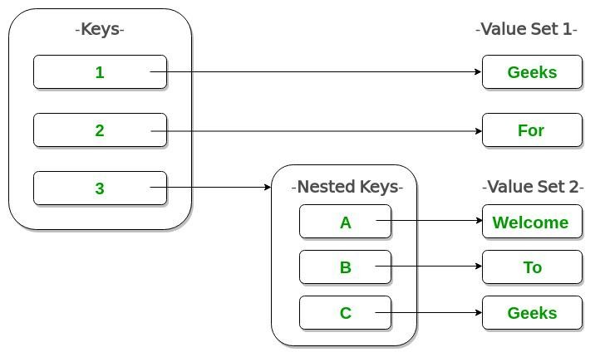
Dictionary with the use of dict():
{1: 'Geeks', 2: 'For', 3: 'Geeks'}
Dictionary with each item as a pair:
{1: 'Geeks', 2: 'For'}
Nested Dictionary:

Slide 73
What is Exception?
An exception is an event, which occurs during the execution of a program that disrupts the normal flow of the program's instructions. In general, when a Python script encounters a situation that it cannot cope with, it raises an exception. An exception is a Python object that represents an error.
When a Python script raises an exception, it must either handle the exception immediately otherwise it terminates and quits.
Handling an exception
If you have some suspicious code that may raise an exception, you can defend
your program by placing the suspicious code in a try: block. After the try: block
, include an except: statement, followed by a block of code which handles the
problem as elegantly as possible.

Slide 74
Syntax
Here is simple syntax of try....except...else blocks −
try:
You do your operations here;
......................
except ExceptionI:
If there is ExceptionI, then execute this block. except ExceptionII:
If there is ExceptionII, then execute this block.
......................
else:
If there is no exception then execute this block.
Here are few important points about the above-mentioned syntax −
A single try statement can have multiple except statements. This
is useful when the try block contains statements that may throw
different types of exceptions.
You can also provide a generic except clause, which handles any exception.
After the except clause(s), you can include an else-clause. The
code in the else-block executes if the code in the try: block does
not raise an exception.
The else-block is a good place for code that does not need the try: block's protection.
Example
This example opens a file, writes content in the, file and comes out gracefully because there is no problem at all −
#!/usr/bin/python
try:
fh = open("testfile", "w")
fh.write("This is my test file for exception handling!!") except IOError:
print "Error: can\'t find file or read data"

Slide 75
else:
print "Written content in the file successfully" fh.close()
This produces the following result −
Written content in the file successfully
Example
This example tries to open a file where you do not have write
permission, so it raises an exception −
#!/usr/bin/python
try:
fh = open("testfile", "r")
fh.write("This is my test file for exception
handling!!") except IOError:
print "Error: can\'t find file or read data"
else:
print "Written content in the file successfully"
This produces the following result −
Error: can't find file or read data

Slide 76
Note: In order to catch an exception, an "except" clause must refer to the same
exception thrown either class object or simple string. For example, to capture above exception
, we must write the except clause as follows −
try:
Business Logic here... except "Invalid
level!":
Exception handling here...
else:
Rest of the code here...
User-Defined Exceptions
Python also allows you to create your own exceptions by deriving classes from the standard
built-in exceptions.
Here is an example related to RuntimeError. Here, a class is created that is subclassed from
RuntimeError. This is useful when you need to display more specific information when an
exception is caught.
In the try block, the user-defined exception is raised and caught in the except block. The
variable
e is used to create an instance of the class Networkerror.
class Networkerror(RuntimeError): def init
(self, arg):
self.args = arg

